Slide 1
Student IT induction

Slide 2
What we’ll cover
Logging in to online services
Password Self-service
MyDMU
Student Email
Blackboard (Virtual Learning Environment)
Library resources & printing
Campus Wifi
IT training
Where to find support and who to contact for help with IT

Slide 3
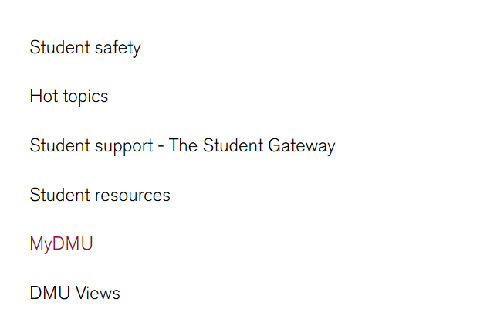
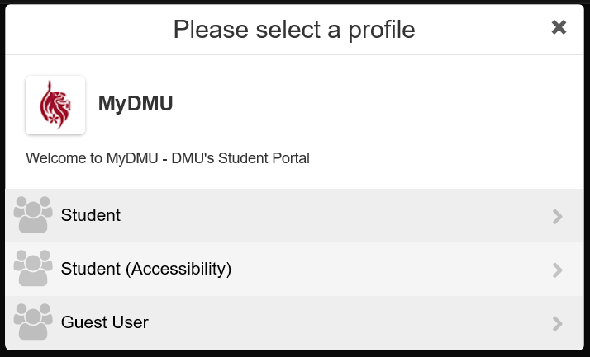
University website
dmu.ac.uk
To access your personal information portal – myDMU – from the DMU Website
1 >
2 >
3 >
Notes:
To access your personal information portal – called MyDMU - from the DMU website (http://dmu.ac.uk)
Select Current Students
Select MyDMU
Select Student
NOTE: If you require an accessible version of the MyDMU portal use the Student (Accessibility) link

Slide 4
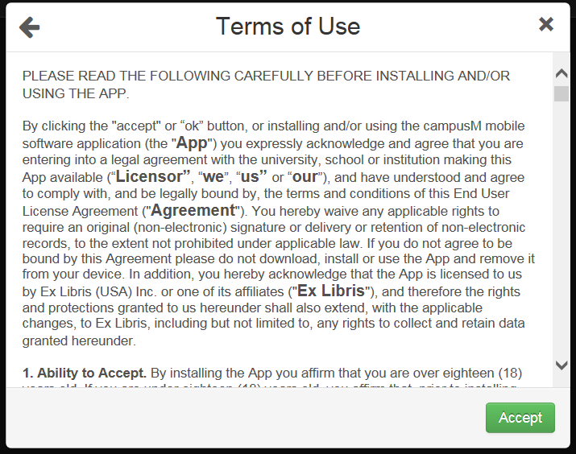
First time login to MyDMU
4 >
Notes:
5. Click the Accept button

Slide 5
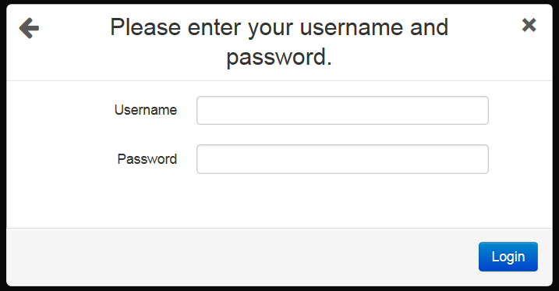
MyDMU
5 >
Notes:
6. Login with your student username and password
Your username and password will have been communicated to you as part of your induction. If you do not know what your login details are; contact the ITMS Service Desk itmsservicedesk@dmu.ac.uk or Ext: 6050

Slide 6
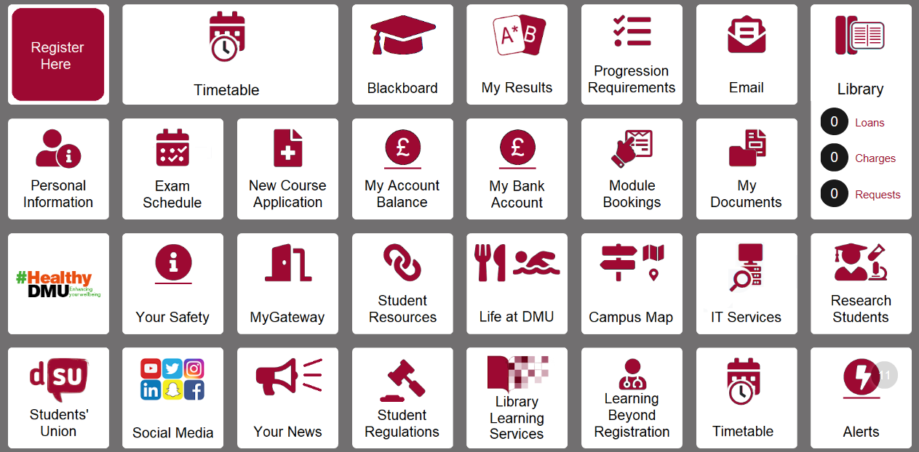
MyDMU
http://my.dmu.ac.uk
Notes:
MyDMU contains personalised data e.g. your timetable, personal details , your course details, access to your emails, Blackboard, social media and more.

Slide 7
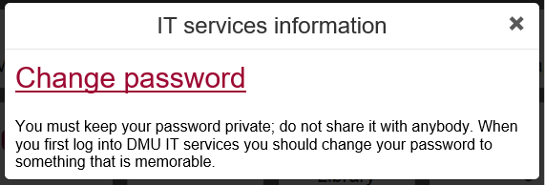
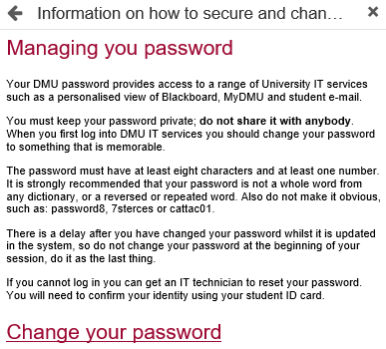
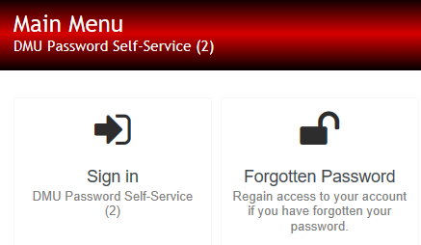
Password Services
1 >
2 >
4 >
3 >
Notes:
It is recommended that you change the temporary password that was given to you.
Click the IT Services tab
Click Change password
Click Change your password
Sign in using your current password and follow the on-screen instructions to change your password
Alternatively you can type password.dmu.ac.uk in your web browser to access the Password Self Service
The password self service also allows you to set security questions which are used to recover a forgotten password.

Slide 8
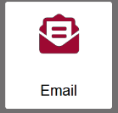
Your Email
Access via the Email tile in MyDMU
Your email address is your student “P” number @my365.dmu.ac.uk
E.g. P12345678@my365.dmu.ac.uk
Any questions regarding the email system can be emailed to
office365feedback@dmu.ac.uk
Notes:
You can access your student email account from the Email tile in MyDMU. Your email address is your student id number, including the P, @my365.dmu.ac.uk. E.g. p12345678@my365.dmu.ac.uk
Questions about the email system should be emailed to office365feedback@dmu.ac.uk

Slide 9
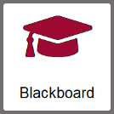
Blackboard VLE
Blackboard is a web-based virtual learning environment (VLE) used at DMU to support your learning.
Blackboard can be accessed via the Blackboard tile in MyDMU
Notes:
Blackboard is a web-based virtual learning environment (VLE) used at DMU to support your learning. Blackboard provides access to online learning materials from any computer with internet access. It enables you to continue your learning activities, collaborate and access resources away from the classroom.

Slide 10
Blackboard VLE
Or you can access it directly via your web browser at:
https://vle.dmu.ac.uk
Blackboard is NOT compatible with the Internet Explorer web browser
It is compatible with the latest versions of Google Chrome, Firefox,
Microsoft Edge, and Safari.
Notes:
Blackboard can be accessed directly at: https://vle.dmu.ac.uk
Blackboard is NOT compatible with the Internet Explorer web browser.
It is compatible with the latest versions of Google Chrome, Firefox, Microsoft Edge, and Safari

Slide 11
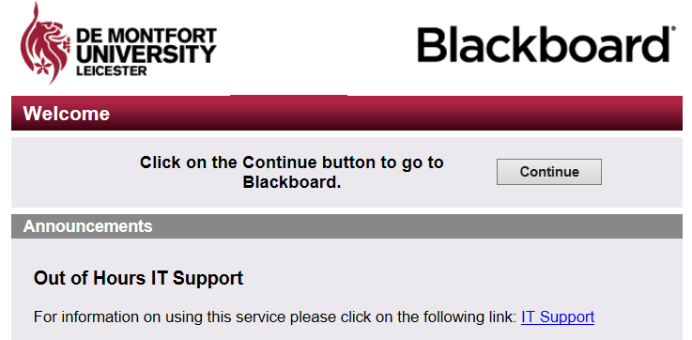
Blackboard VLE
1 >
Notes:
1. Click the Continue button

Slide 12
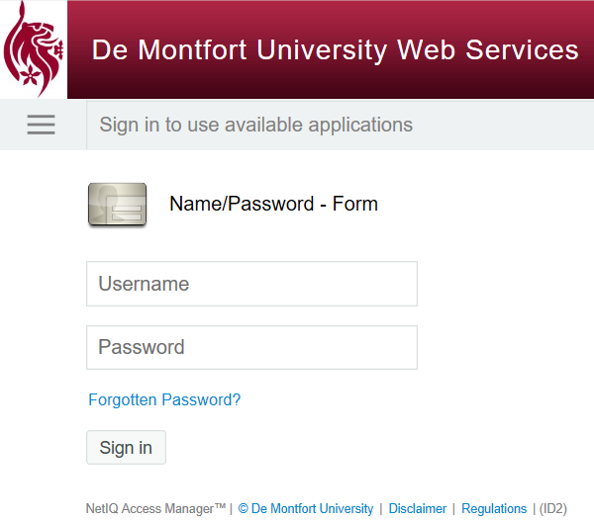
Blackboard VLE
2 >
Notes:
1. Login with your student username and password

Slide 13
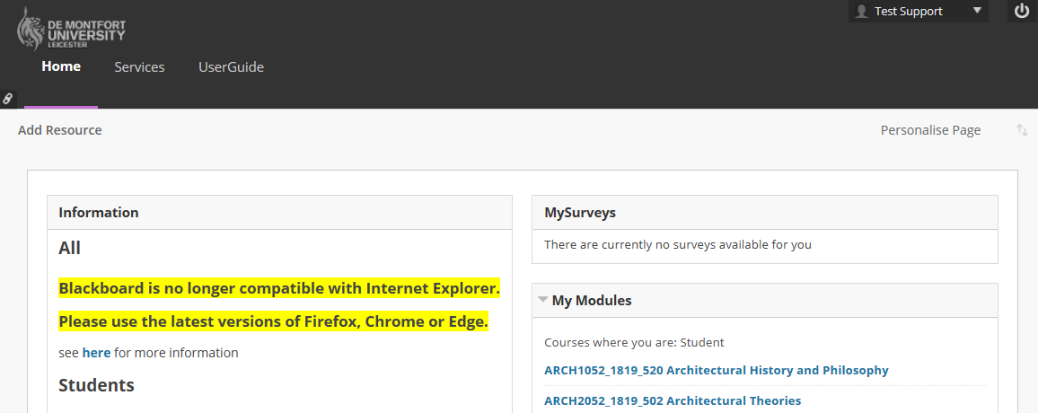
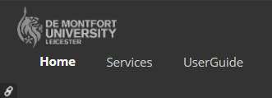
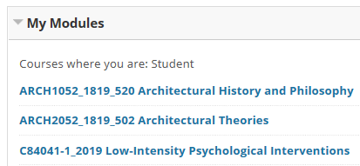
Blackboard VLE
Link to the User Guide
Individual module links
Notes:
Each module on which you are enrolled has its own online space which can be accessed from the My Modules panel in Blackboard
For more detailed information about the functionality of Blackboard click the UserGuide tab, which will take you to the Student Support for Learning Technologies site.

Slide 14
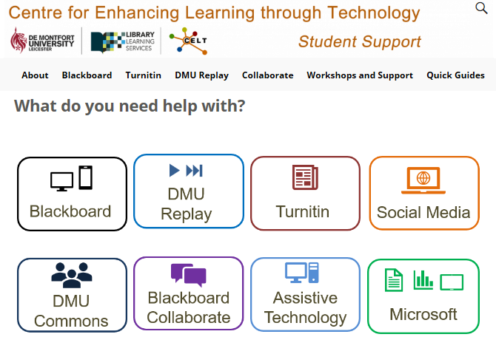
Blackboard - UserGuide
http://celtstudent.our.dmu.ac.uk/
Notes:
The Student Support site contains basic ‘How to’ guides concerning the core functions of Blackboard and associated teaching, learning and assessment technologies.
http://celtstudent.our.dmu.ac.uk

Slide 15
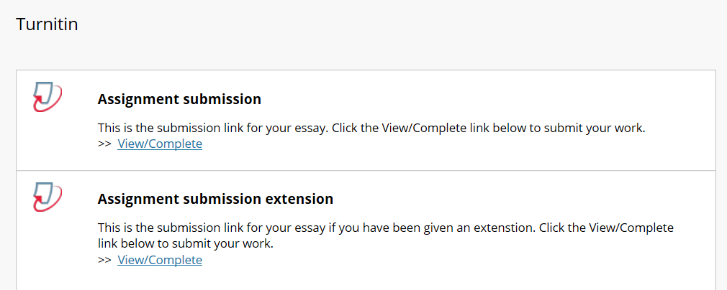
Turnitin
You may be required to submit your written work electronically through Turnitin. This software assists academic staff in identifying possible plagiarism, collusion or other academic offences.
Notes:
Your module tutors will advise you on the procedure for submitting your written work, and viewing your feedback and grades.

Slide 16
DMU replay
All staff led teaching sessions will be recorded, so that you can revisit them. This system is called DMU Replay.
DMU Replay recordings can be viewed by clicking the link in your module
Click here to see what a DMU Replay Recording looks like
Notes:
Your module tutors will explain what DMU Replay means in practice.
Link to view an example of a DMU Replay recording:
http://celt.our.dmu.ac.uk/dmu-replay-the-student-view-including-navigation-and-search/

Slide 17
Kimberlin Library – IT Resources
WiFi across all spaces
Hundreds of computer workstations
Wide range of software installed
Assistive technologies
Syndicate rooms with digital multimedia hardware
Laptop loans
IT Help Desk – on 1st Floor
For more information about library services visit our website using the following link
http://library.dmu.ac.uk/
Notes:
The Kimberlin Library has a range of IT services available.
https://libguides.library.dmu.ac.uk/computers

Slide 18
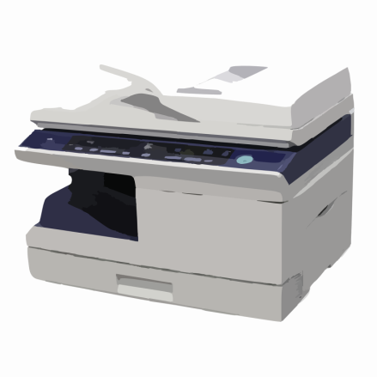
Printing
Use your student card to print from any machine on campus
Printers are available in all student areas
Manage your printing and print top-up online at http://printing.dmu.ac.uk
You can also print content from your mobile device
For more information about mobile printing: http://mobileprint.dmu.ac.uk
For more information on how to print or top-up your print credits, use our IT help guide which can be found in the Kimberlin library
If you need any further help with printing contact
ITMS Service Desk
itmsservicedesk@dmu.ac.uk
Ext: 6050
Notes:
There are wifi enabled printers located across the campus

Slide 19
Campus Wide Wireless Network
Completely FREE
A one-time only sign on
A secure connection
Available anywhere you see the eduroam logo, this includes other universities and educational locations
Paper-based help guides are available to show you how to connect to eduroam. These can be found in all student learning zones and the Kimberlin Library.
Online help can be found at: eduroam.dmu.ac.uk
Compatible with:
Apple iPhone, iPod or iPad
Apple OS X
Google Android
Linux
Microsoft Windows Vista
Microsoft Windows 7
Microsoft Windows 8 / 8.1
Microsoft Windows 10
Microsoft Windows Phone 8
Notes:
The Campus wide wireless network is provided by Eduroam.

Slide 20
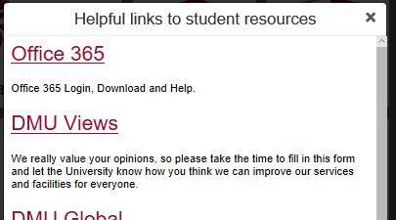
Microsoft Office 365
All students have access to Microsoft Office 365
To access your account:
1 >
2 >
You can download Office 365 software for free on up to 5 PCs and 5 mobile devices
Your copy of Office 365 will remain active until you graduate
Notes:
To access your Microsoft Office 365 account:
Click the Student Resources tile
Click the Office 365 link

Slide 21
Microsoft Office 365 Support
There are a number of resources to help you download and set up
Office 365 - available at:
https://demontfortuniversity.sharepoint.com/sites/support365/SitePages/Home.aspx
You will need to sign in using your usual account details to access these resources.
Online training resources can be found at:
https://support.office.com/en-gb/office-training-center
If you have any problems accessing Office 365 you can email office365feedback@dmu.ac.uk
Or contact the ITMS service desk by phone or email
Notes:
There are a range of Microsoft Office 365 support materials:
https://demontfortuniversity.sharepoint.com/sites/support365/SitePages/Home.aspx
https://support.office.com/en-gb/office-training-center
For help accessing Office 365: email office365feedback@dmu.ac.uk

Slide 22
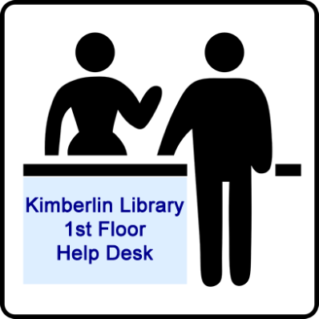
Help and Support
ITMS Service Desk
itmsservicedesk@dmu.ac.uk
Ext: 6050
Notes:
The main IT support portals are:
The IT Induction and support for learning technologies guide [https://libguides.library.dmu.ac.uk/celtguide/home]
The ITMS service desk [itmsservicedesk@dmu.ac.uk] Ext: 6050
The IT Services tile on MyDMU
The Kimberlin Library 1st Floor Helpdesk

